Slide 1
ExampleS

Slide 2

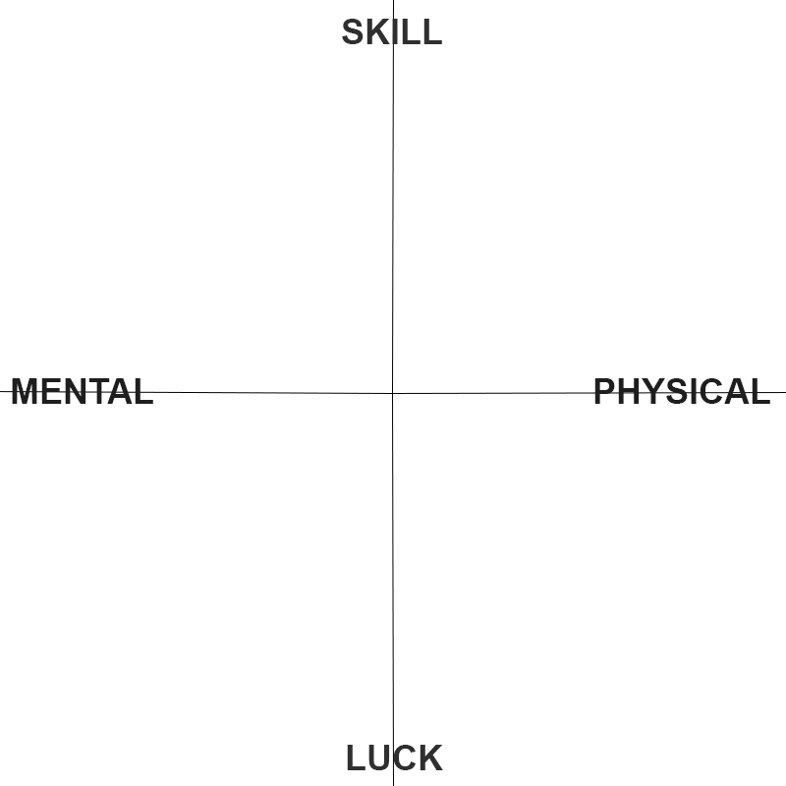
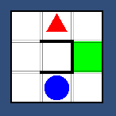
Escape the Minotaur
Short description: Theseus has to survive the deadly minotaur by finding hid way out from the labyrinth.
Myth Name: Minos’s Bull
Protagonist(s): Theseus (Blue Circle)
Obstacles: Minotaur (Red Triangle) Walls (Black)
Goal: Remain on exit on your turn (Green Square)
Challenge: Pursuing enemy
Verbs: Follow, Hide, Plan, Catch
Genre: Turn-Based Puzzle game
Matrix:
Mockup:

Slide 3
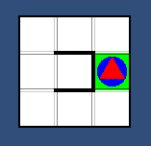
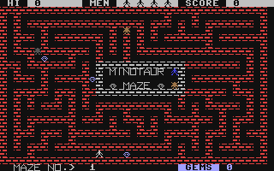
Escape the Minotaur
Existing Examples:
Sokoban
Minotaur Maze
Gameplay overview:

Slide 4
Sources
Carloseow. 2011. A Sokoban puzzle being solved. [online] Available at: <https://en.wikipedia.org/wiki/Sokoban#/media/File:Sokoban_ani.gif> [Accessed 03 November 2021].
Encyclopedia Britannica. 2001. Minotaur | Definition, Story, & Facts. [online] Available at: <https://www.britannica.com/topic/Minotaur> [Accessed 03 November 2021].
Blakemore, C., 1986. Minotaur Maze. USA: Ahoy!/Ion International, Inc.

Slide 5
Jordan Akehurst

Slide 6
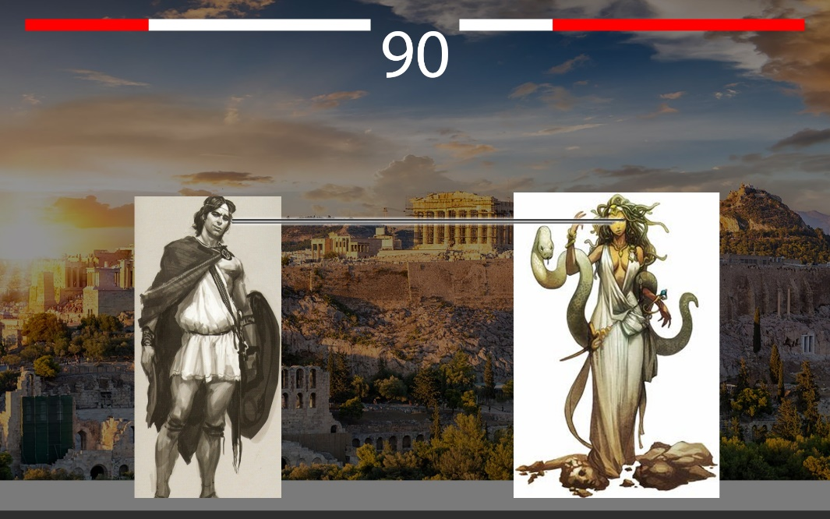
The Stone queen
Short description:
Perseus, who was the son of Zeus, had help from the gods on his quest to find and behead Medusa.
Myth Name: Medusa
Protagonist(s): Perseus (Left)
Obstacles: The Gorgons (Right)
Goal: Reach & kill Medusa
Challenge: Defeat sisters, Kill Medusa
Verbs: Chase, Hide, Kill
Genre: Arcade 2D Fighter
- Matrix:
Mockup:
Notes:
Fill out all of the fields. Choose on one Matrix
Offer contextualise game mockup

Slide 7
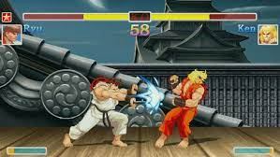
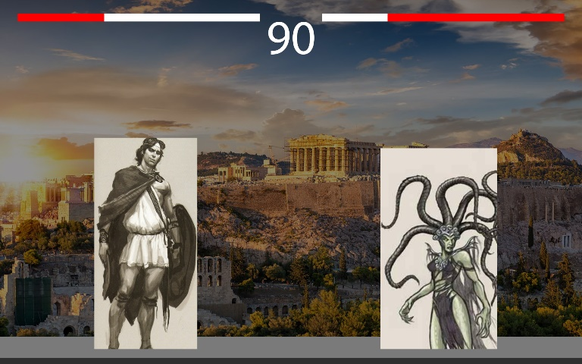
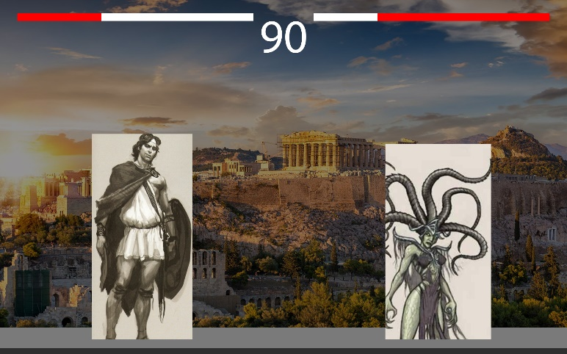
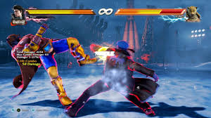
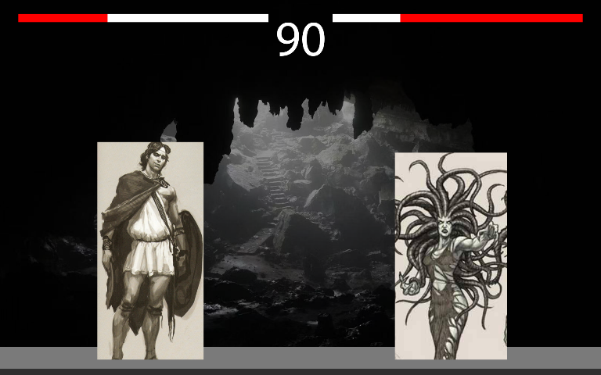
The stone queen
Existing Examples:
Street Fighter
Tekken
Gameplay overview:
Notes:
Discuss gameplay overview in greater detail
Provide examples of games/cultural artefacts as references. Create a Moodboard of sorts.

Slide 8
Sources
Tekken 7. 2021. [Online] https://mp1st.com/wp-content/uploads/2021/05/tekken-7-image.jpg
Street Fighter 2. 2017. [Online] https://img.redbull.com/images/c_crop,x_0,y_50,h_456,w_912/c_fill,w_1920,h_960/q_auto,f_auto/redbullcom/2017/05/26/8e9df911-f4d9-48c0-81cf-a7f1a3a01b9a/ultra-street-fighter-2-switch
Madeleine. 13/09/2019. The Myth of Perseus and Medusa Explained. [Online] https://www.theoi.com/articles/the-myth-of-perseus-and-medusa-explained/
Notes:
Don’t forget to harvard reference your sources

Slide 9
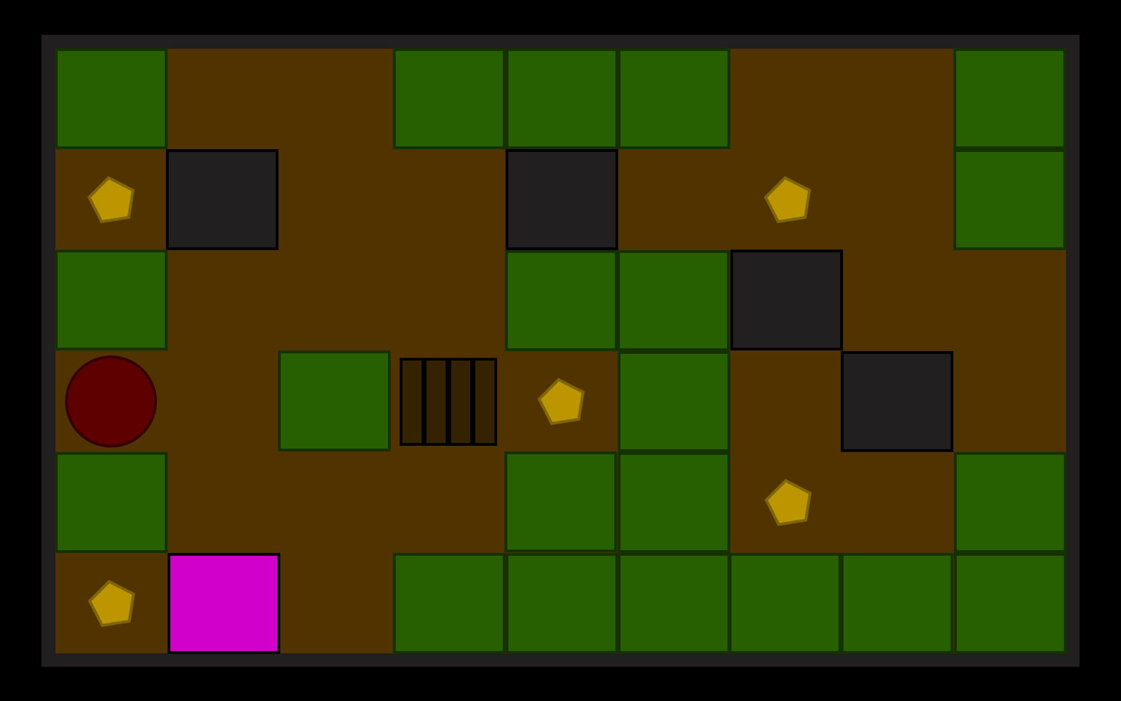
The box of hopes
Short description:
Pandora finds and opens a box releasing all but hope.
Myth Name: Pandora’s Box
Protagonist(s): Perseus (red)
Obstacles: Blocked Entrances (grey)
Goal: Find parts in Rome to fix box (stars)
Challenge: Order of completion
Verbs: Push, Collect, Manoeuvre
Genre: Puzzle-like, Top down adventure
Matrix:
Mockup:
Notes:
Fill out all of the fields. Choose on one Matrix
Offer contextualise game mockup

Slide 10
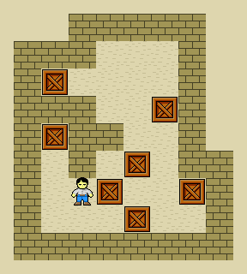
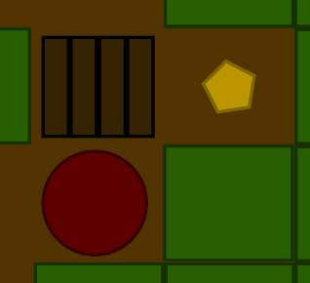
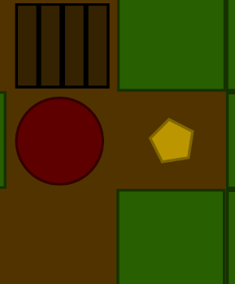
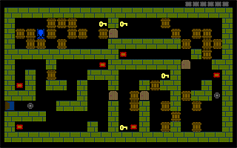



The box of hopes
Existing Examples:
Sokoban
Spych
Gameplay overview:
Notes:
Discuss gameplay overview in greater detail
Provide examples of games/cultural artefacts as references. Create a Moodboard of sorts.

Slide 11
Sources
Carloseow. 2011. A Sokoban puzzle being solved. [Online] https://en.wikipedia.org/wiki/Sokoban#/media/File:Sokoban_ani.gif
Qyadko. 02/11/2014. Polish SokoBan Tank game: Spych. [Online] DOSGames Forum. http://www.dosgames.com/screens/spych.gif
Britannica, The Editors of Encyclopaedia. Pandora. [Online] https://www.britannica.com/topic/Pandora-Greek-mythology
Notes:
Don’t forget to harvard reference your sources

Slide 12
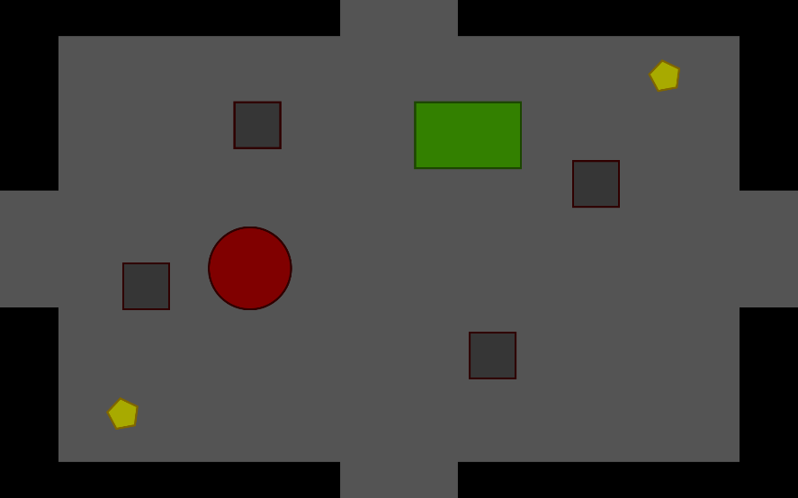
The Empty labyrinth
Short description:
14 boys and girls sent to the labyrinth to feed the Minotaur.
Myth Name: The Meal of the Minotaur
Protagonist(s): Boy/Girl (red)
Obstacles: Minotaur (green)/Block (dark grey)
Goal: Find the exit, move from room to room
Challenge: Random room/Obstacles, chased by minotaur
Verbs: Run, collect, enter, exit
Genre: Rougelike
Matrix:
Mockup:
Notes:
Fill out all of the fields. Choose on one Matrix
Offer contextualise game mockup

Slide 13
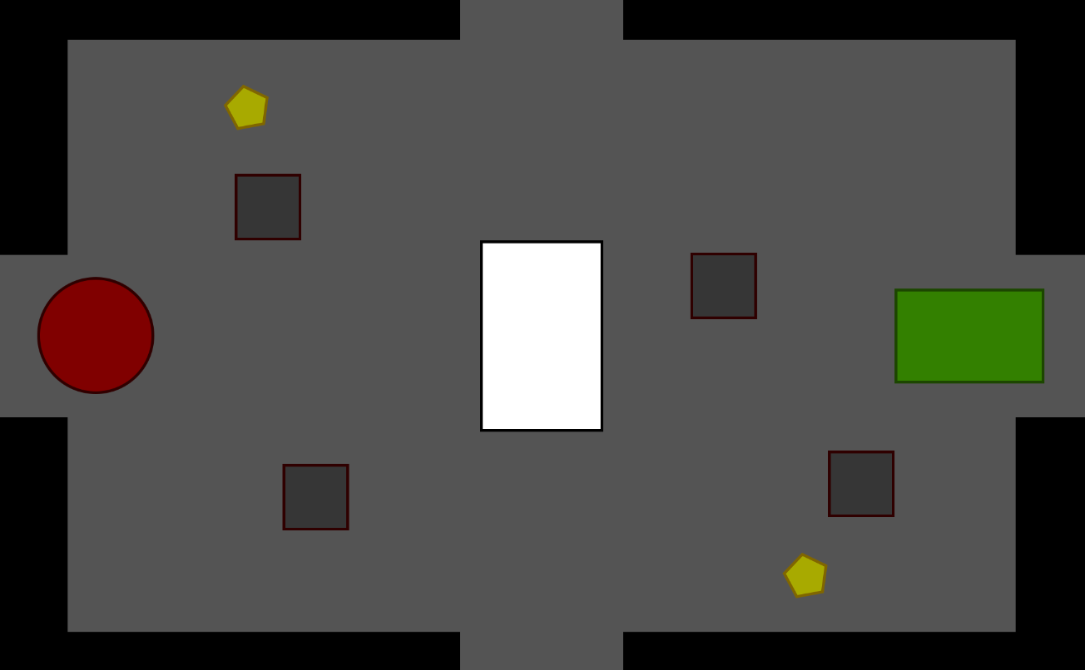
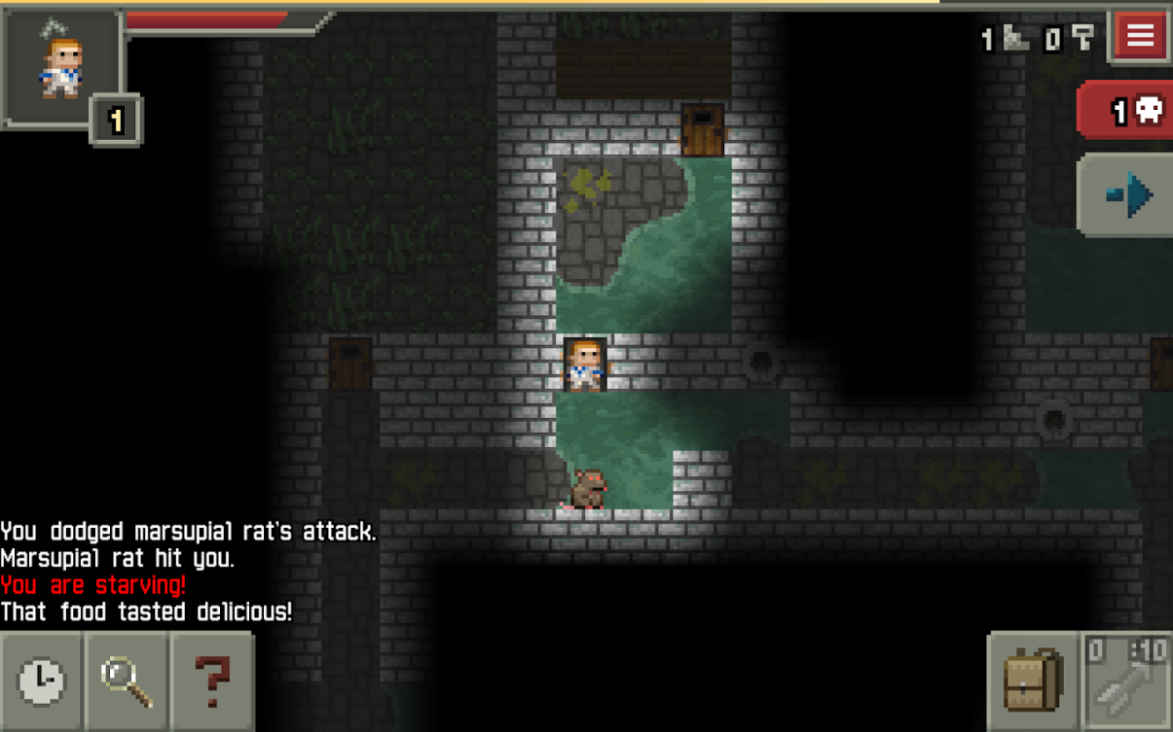
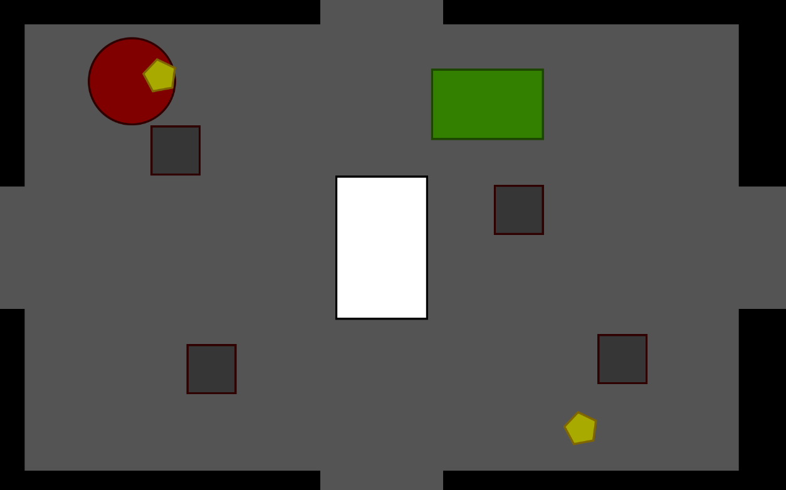
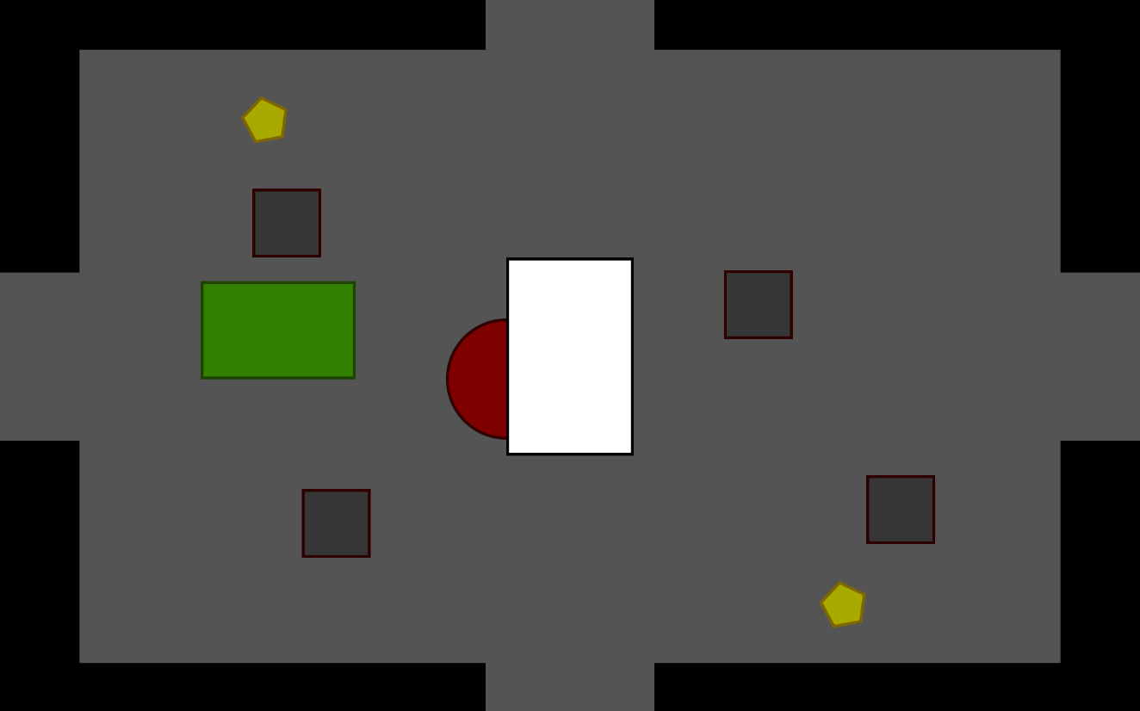
The empty labyrinth
Existing Examples:
Pixel Dungeon
Gameplay overview:
Notes:
Discuss gameplay overview in greater detail
Provide examples of games/cultural artefacts as references. Create a Moodboard of sorts.

Slide 14
Sources
Pseudo_Intellectual, 19/10/2016. Pixel Dungeon Promo Art. MobeyGames [Online] https://www.mobygames.com/game/pixel-dungeon/promo/promoImageId,106428/
Greek Mythology.The Meal of the Minotaur, Minotaur. [Online] https://www.greekmythology.com/Myths/Monsters/Minotaur/minotaur.html
Notes:
Don’t forget to harvard reference your sources

